Slide 1
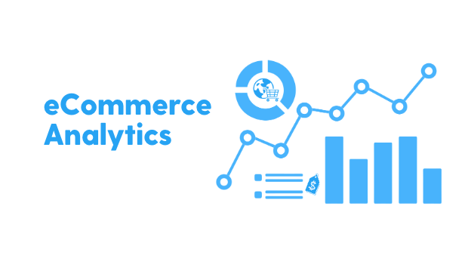
E COMMERCE ANALYSIS
report

Slide 2
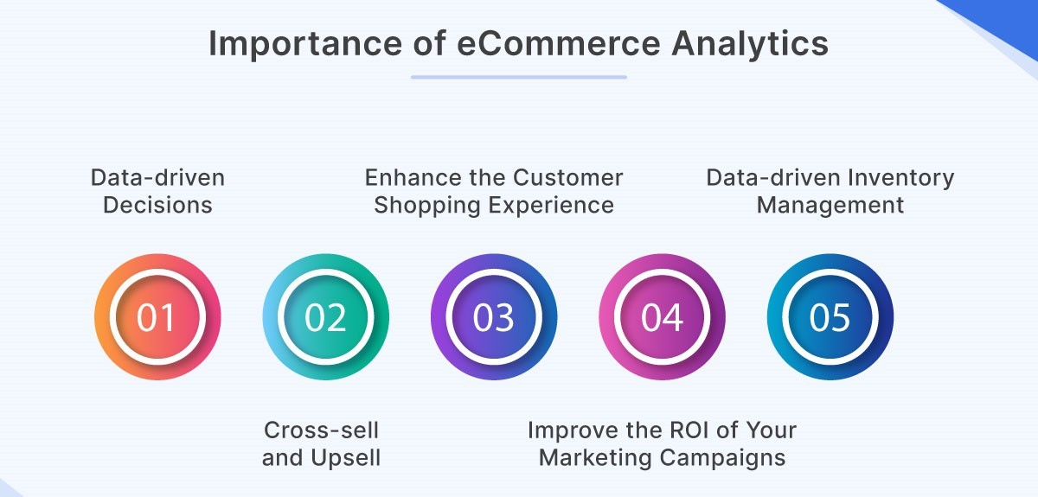
introduction
This report aims to give some important insights which will be helpful for the company to better understand their customers.
It will help the company create a customer base, enhancing the customer experience and recommend relevant products to the customers while increasing their revenue.

Slide 3

Tools & material
Data analysing tools like Python in Google colab were used in analysing the given data sets.
Our datasets included Customer.csv and Purchase.csv
The contain all necessary details such as orders, customer demographics, products, segment information, quantity, shipping cost etc.

Slide 4

Key Insights
Average order Value
Purchase Frequency
Customer Segments
Demographics and Behavioral Segments
High value Segments
Top selling products
Churn Rate
Trands and pattens

Slide 5
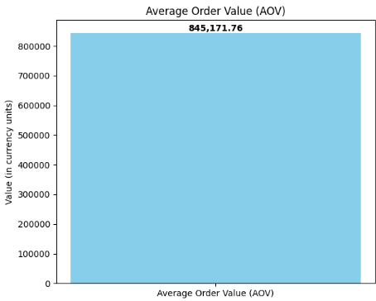
Average order Value
Avo represents the average revenue generated per order across all customers.
In our calculation of it using the (total revenue / total orders) we got 845171,76
Meaning that each order contributes significantly to total revenue.
Which also means customers are buying a lot

Slide 6
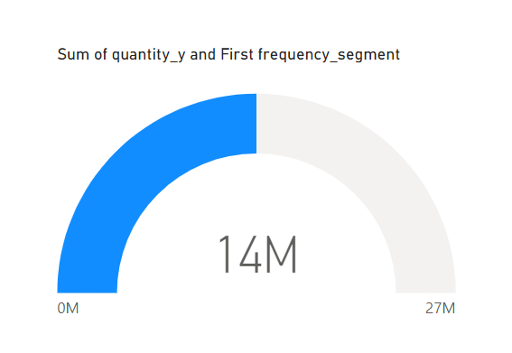
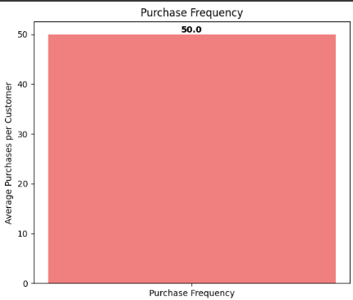
Purchase frequency
Our Purchase frequency came out as 50
Which indicates that on average each customer makes 50 purcahses within observed timeframe
It also shows that in our sum of quantity and frequency segment shown above

Slide 7
Key take out points(Suggestions) in our aov and purchase frequency
The business needs to compare its AOV against industry standards or past AOVs for their business to see if it’s high or low. If AOV is significantly high, investigate if there are specific products or categories driving it.
For Purchase Frequency: If the frequency is higher than expected, it may point to high customer retention. Identify the reasons driving repeat purchases for example subscription model, popular product categories.
Tracking these KPIs over time and segmenting them by customer demographics or purchase categories can offer even deeper insights into customer behaviours and areas for potential growth

Slide 8
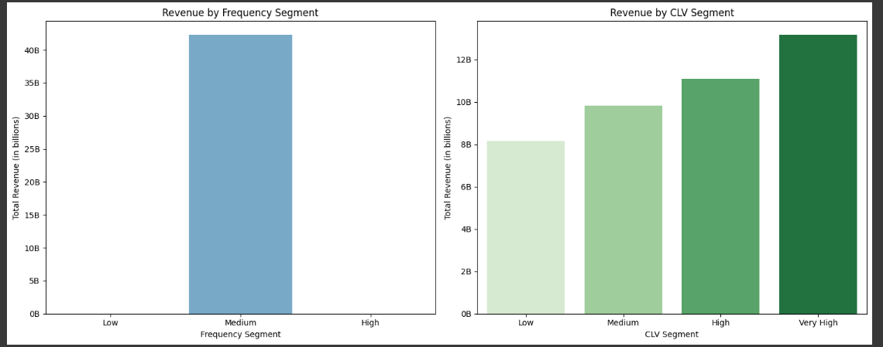
Customer Segments Insights
We created Demographics and Behavioural Segments then used it to identify high value segments.
These segemnts included Revenue frequency as well as revenue by CLV segments
The revenue_frequency came out as medium with 4,22
While CLV_Segment shown results in low, medium, high and very high as shown in the table below

Slide 9
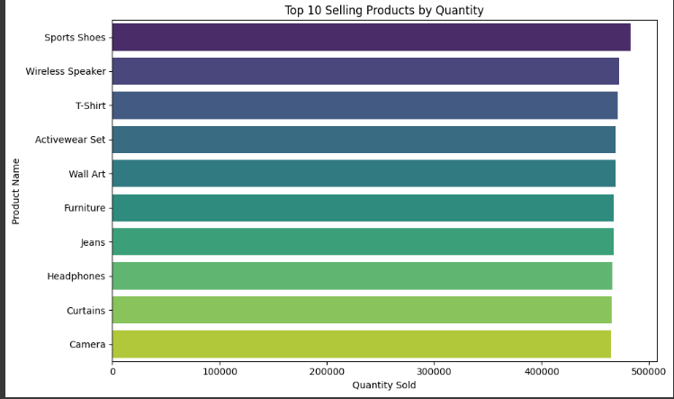
Top selling products
We also identyfiled Top 10 selling procuts:
We can see that Sport shoes are leading with a quantity of 783107 units.

Slide 10
Interpretation for High_value_segments & Top_selling_products
High_Value_Segments:
Medium Frequency Segment: Generates 42.26 billion in revenue, indicating that this is the primary segment driving sales. This suggests that customers who purchase at a medium frequency are crucial for revenue generation and may form a reliable core segment.
Very High CLV Segment: Generates the most revenue at 13.17 billion
Revenue Scaling: The smooth progression from Low to Very High CLV segments (from 8.17 billion to 13.17 billion) suggests that customers in higher CLV tiers are indeed adding more value, possibly through larger or more frequent purchases
.

Slide 11
Key Take out points in customer segments
High-CLV customers are essential to the business’s revenue and may represent a loyal, high-spending base. It would be beneficial to focus on retention and loyalty initiatives for these customers to ensure they continue contributing.
The business must Focus on Medium-Frequency, High-CLV Customers: Since these groups drive most of the revenue, consider tailoring marketing, promotions, or loyalty programs to them.
There is Revenue Potential in High-Value Segments: For Very High CLV customers, the business must focus on retention, upselling, and exclusive offers to maximize their lifetime value further.
They must also Investigate Anomalies: Check why High frequency shows zero revenue, as these customers are usually valuable.
Under Top selling products business must identify trends of popular items to help optimize inventory mor marketing strategies.

Slide 12
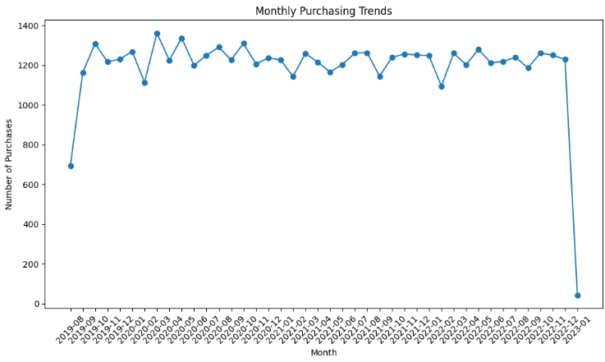
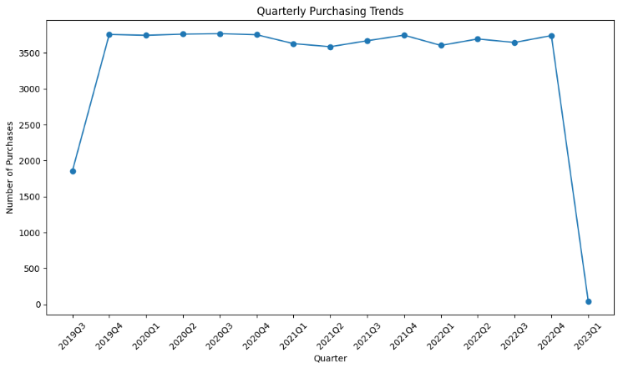
Trends & Patterns
Purchase over Time: Monthly and Seasonal
If we focus on the spikes, we can see that there are peak times as well as slow times. For example, the month of Aug & Jan seem to bee the ones that have significant slow purchasing.
while Dec & March have the highest peak times.
We can see that there is consistency in these patterns meaning the business must know that there is a recurring seasonal demand.
Peaks in Q4 maybe driven by holiday demand
Drops in Q1 may reflect post holidays

Slide 13

Insights and key take out points
If the quarterly pattern repeats year after year, it could highlight strong seasonal trends. For example, strong Q4s year-over-year would confirm the impact of year-end holidays or major events. Meaning there is performance across years and business must be aware of that.
The business must also check whether there is a steady improvement in sales over quarters each year. This would signal strong performance, especially if the quarterly numbers increase in the same period across years.
Seasonality: If certain months or quarters consistently perform better, consider planning more aggressive marketing strategies, inventory management, or promotional efforts during these periods.
Off-Season Strategies: If you see clear periods of decline, you might want to explore strategies to boost sales in low-demand periods, like offering discounts or targeting niche markets.
Impact of Marketing Campaigns: Spikes that don’t align with typical seasonality could be due to marketing efforts or promotions. If available, compare these trends with historical marketing activity to understand cause and effect.

Slide 14

THE END!

